Slide 1



SETH GOVIND RAGUNATH SABLE COLLEGE OF PHARMACY
SASWAD
Mrs. Jagtap P.N
Assistant Professor & HOD of Pharmacology.
PDEA’S SGRS College of Pharmacy.

Slide 2
Heart rhythm is normally controlled by a natural pacemaker (sinus node) located in the right atrium. The sinus node produces electrical impulses that normally start each heartbeat. These impulses cause the atria muscles to contract and pump blood into the ventricles.
The electrical impulses then arrive at a cluster of cells called the atrioventricular (AV) node. The AV node slows down the electrical signal before sending it to the ventricles. This slight delay allows the ventricles to fill with blood. When electrical impulses reach the muscles of the ventricles, they contract, causing them to pump blood either to the lungs or to the rest of the body.
Antiarrhythmic agents
Antiarrhythmic drugs are used to prevent or treat irregularities of cardiac rhythm.

Slide 3
Arrhythmia, also known as cardiac arrhythmia or heart arrhythmia, is a group of conditions in which the heartbeat is irregular, too fast, or too slow.
Types:
Tachycardia- above 100 beats per minute in adults
Bradycardia-below 60 beats per minute.
Ventricular Tachycardia
Atrial Flutter & Fibrillation (More than 300)
Causes: Mayocardial Hypoxia, Ischemia, Trauma, Drugs, electrolyte Disturbance, ANS
Symptoms when present may include palpitations or feeling a pause between heart beats, Fatigue, breathlessness, Herat fail or cardiac arrest.

Slide 4
Pathophysiology of Arrythmia
Abnormal generation of impulse
Altered normal automaticity
Abnormal automaticity
After depolarization---i) Early ii) Delayed
2. Abnormal Conduction of impulse
Reentry
Conduction block I, II, III

Slide 5
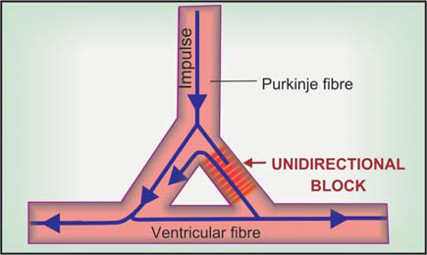
• Reentry –
Primarily due to abnormality of conduction, an impulse may recirculate in the heart and cause repetitive activation without the need for any new impulse to be generated. These are called reentrant arrhythmias.

Slide 6
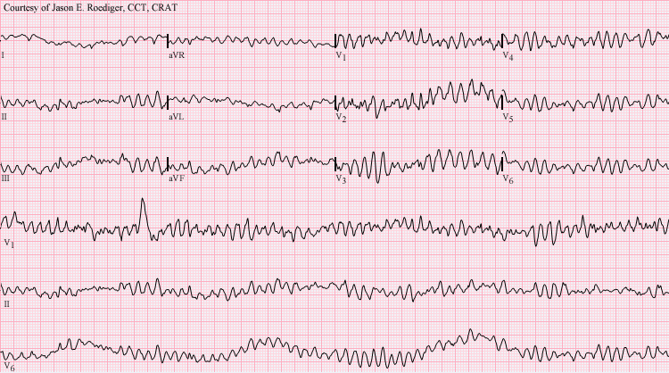

Slide 7
Vaughan Williams KBSC
Antiarrhythmic drug classes:
Class I - Sodium-channel blockers
Class IA: Prolong repolarization
e.g : Quinidine, Procainamide
Class I B: Shorten repolarization
e.g : Lignocaine,Phenytoin
Class I C: Little effect on repolarization
e.g : Propafenone
Class II - Beta-blockers
e.g : Propranolol, Esmolol
Class III - Potassium-channel blockers: Prolong repolarization
e.g : Amiodarone, sotalol
Class IV - Calcium-channel blockers
e.g : Verapamil, Diltiazem

Slide 8
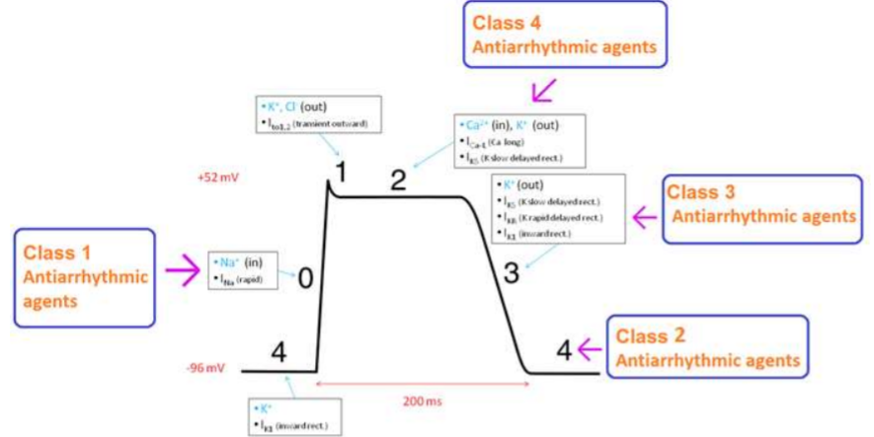

Slide 9
Class I - Sodium-channel blockers
Class IA: Prolong repolarization, e.g : Quinidine, Procainamide
↓ Automaticity in all cell.
↓ Phase 0 depolarization.
↑Threshold to excitability.
↓Responsiveness & conductance.
Propagation of action potential
Abolish re-entrant arrhythmia

Slide 10
Extra cellar
Extracellular
M Gate Na
M gate
Na
Na
H gate
H gate
Intracellular
Intracellular

Slide 11
Quinidine:
• Quinidine causes fall in BP due to its weak α adrenergic blockade action and direct cardiac depression property.
• Quinidine also has mild anticholinergic actions.
• Quinidine also decreased skeletal muscle contractility, augmented uterine contractions, vomiting, diarrhoea and neurological effects like ringing in ears, vertigo, deafness, visual disturbances and mental changes.
• Levo isomer of quinidine used as an antimalarial agent, and has been used as a parenteral alternative to quinine for falciparum malaria.

Slide 12
Quinidine:
• Therapeutic use:
– Quinidine effective in many atrial and ventricular arrhythmias, it is rarely used now, because of risk of adverse effects, including that of torsades de pointes (abnormal heart rhythm that leads to death), sudden cardiac arrest or Ventricular fibrillation (VF); vascular collapse, thrombocytopenia,
Procainamide and disopyramide:
• Therapeutic use:
– Procainamide is available in an intravenous formulation only and may be used to treat acute atrial and ventricular arrhythmias.
– Disopyramide is used in the treatment of ventricular arrhythmias as an alternative to procainamide or quinidine and may also be used for maintenance of sinus rhythm in atrial fibrillation or flutter.

Slide 13
Class I B: Shorten repolarization , e.g : Lignocaine,Phenytoin
• The most prominent cardiac action of lidocaine is suppression of automaticity in ectopic foci.
↓ Automaticity in Purkinje cells.
↓ Abnormal & triggered activity
↓ Slope of Phase 4
↑excitability threshold
No change in action potential
Abolish re-entrant ventricles.

Slide 14
• Adverse effects:
– Lidocaine has a fairly wide therapeutic index. It shows little impairment of left ventricular function .
– Drowsiness, nausea, blurred vision, disorientation, twitchings and fits.

Slide 15
Class I C: Little effect on repolarization e.g : Propafenone
Propafenone:
1. Powerful Na blocker
↓ Premature ventricular depolarization.
Automaticity in pace maker.
↓ responsiveness & conductance

Slide 16
Class IA:
Prolong repolarization, e.g : Quinidine, Procainamide
↓ Automaticity in all cell.
↓ Phase 0 depolarization.
↑Threshold to excitability.
↓Responsiveness & conductance.
Propagation of action potential
Abolish re-entrant arrhythmia
Class I B:
Shorten repolarization , e.g : Lignocaine,Phenytoin
↓ Automaticity in Purkinje cells.
↓ Abnormal & triggered activity
↓ Slope of Phase 4
↑excitability threshold
No change in action potential
Abolish re-entrant ventricles.
Class I C:
Little effect on repolarization e.g : Propafenone
Propafenone:
Powerful Na blocker
↓Premature ventricular depolarization.
Automaticity in pace maker.
↓ responsiveness & conductance

Slide 17
Class II Antiarrhythmic Drugs Antiadrenergic agents (β blockers)
e.g: Propranolol, Sotalol, Esmolol :
Cardio selective & non selective
↓ Slope of Phase 4 action potential, ↓ firing rate
↓ Automaticity in SA node & Purkinje cells.
Don’t have effect on excitability.
↓ conduction velocity in AV node.
↓ refractory period in AV node.
Don’t alter duration of action potential
Abolish re-entrant ventricles.

Slide 18
Class III Potassium Channel Blocker
Amiodarone, Dronedarone, Dovetailed, Ibutilide:
Prolong duration of AP & delay Repolarization
Powerful Antiarrhythmic Agent.
Block K+ channel & Prolong APD.
Also Block Na+ and Ca+ channel
Block Beta Adrenergic receptor.
Depress SA node .
Prolong AP in auricles & Ventricles.
Shorten AP duration in Purkinje fibres.

Slide 19
Amiodarone:
• Interactions:
– Amiodarone can increase digoxin and warfarin levels by reducing their renal clearance.
– Additive A-V block can occur in patients receiving β blockers or calcium channel blockers.
• Adverse effects:
• Amiodarone shows a variety of toxic effects, including pulmonary fibrosis, neuropathy, hepatotoxicity, corneal deposits, optic neuritis, blue-gray skin discoloration, and hypo- or hyperthyroidism.

Slide 20
Dofetilide:
• It is a pure class III antiarrhythmic (pure potassium channel blocker).
• Dofetilide prolongs APD by selectively blocking rapid component of delayed rectifier K+ current without affecting other channels or receptors
Ibutilide:
• is a potassium channel blocker that also activates the inward sodium current (mixed class III and IA action).
• Ibutilide is used i.e. for pharmacological conversion of AFl and AF to sinus rhythm.
• Induction of Torsade's de pointes is a risk.

Slide 21
Class IV calcium Channel Blockers
e.g: Verapamil, Diltiazem:
Block L Type of calcium Channel
Act on SA & AV Node.
↓ High frequency firing
↓ Nodal Conduction.
Prolong AV nodal refractory period.
They supress early & delayed after depolarization.

Slide 22
Other antiarrhythmic drugs
Digoxin:
• Digoxin inhibits the Na+/K+-ATPase pump, and shortening the refractory period in atrial and ventricular myocardial cells while prolonging the effective refractory period and diminishing conduction velocity in the AV node. Digoxin is used to control ventricular response rate in atrial fibrillation and flutter.
• Intravenous magnesium sulfate is the salt used to treat arrhythmias, as oral magnesium is not effective in the setting of arrhythmia.
Magnesium sulfate:
• Magnesium is necessary for the transport of sodium, calcium, and potassium across cell membranes. It slows the rate of SA node impulse formation and prolongs conduction time along the myocardial tissue

Slide 23
Adenosine:
• Adenosine is a naturally occurring nucleoside.
1. In high doses, adenosine decreases conduction velocity,
2. prolongs the refractory period,
3. decreases automaticity in the AV node.
4. Intravenous adenosine is the drug of choice for abolishing acute
supraventricular tachycardia.
• It has low toxicity but causes flushing, chest pain, and hypotension.
• Adenosine has an extremely short duration of action (appro. 10 - 15 sec.) due to rapid uptake by erythrocytes and endothelial cells where it is converted to 5-AMP and inosine.

Slide 24
• Advantages of adenosine for termination of PSVT
– efficacy equivalent to or better than verapamil.
– No hemodynamic deterioration; can be given to patients with hypotension, CHF or those receiving β blockers. Verapamil is contraindicated in these situations.
– Safe in wide QRS tachycardia (verapamil is unsafe).
– Effective in patients not responding to verapamil.

Slide 25
THANK YOU

